Slide 1
Roadmaps and Roadblocks
Future Directions in Small Geometry Processing

Slide 2
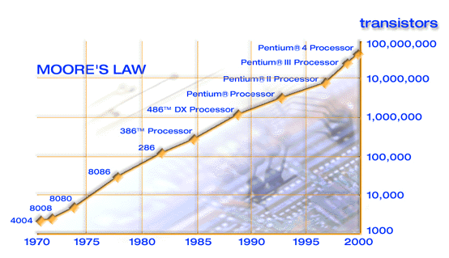
Moore’s law
On chip functionality will double every 18-24 months

Slide 3
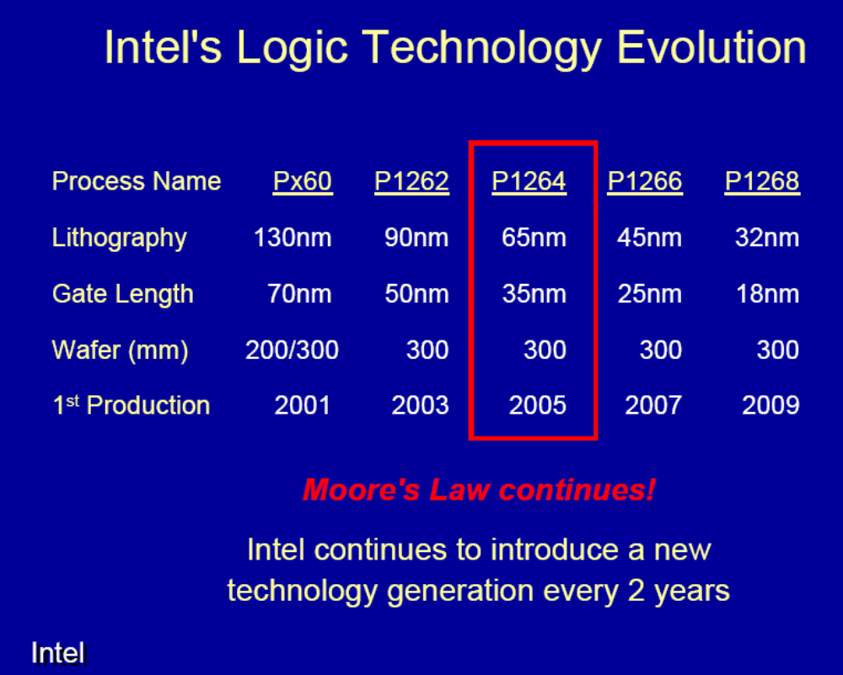

Slide 4
Roadmap
International Technology Roadmap for Semiconductors (ITRS) 2004
ITRS time horizon, 15 years
To date has always had a view of continued scaling of CMOS
Future editions may have more radical approaches to further reducing the cost per function
Each node represents an approximate 70% reduction on the previous

Slide 5
Summary of the SIA Roadmap 2004
(nm)
03
04
2005
2006
2007
2007
2008
2009
2010
2011
2012
2013
2014
2015
2016
90
Volume Production
200
300
70
Volume Production
300
300
65
Volume Production
300
45
Basic steps/Modules
Volume Production
400
450
32
Basic steps/Modules
Integration/Pilot
400
450
22
Advanced research (materials, architecture,..)

Slide 6
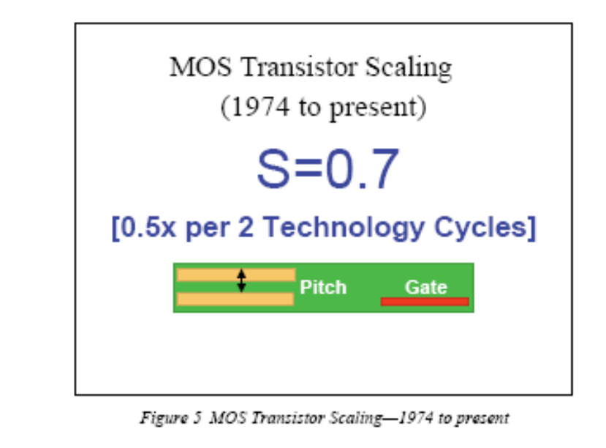
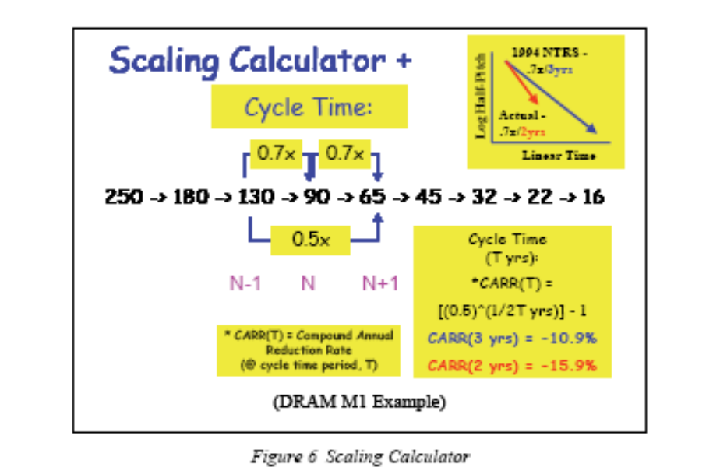

Slide 7

Definition of ½ Pitch
Metal Pitch
Poly Pitch
Typical
MPU/ASIC
Typical
DRAM
Half Pitch = Pitch/2

Slide 8
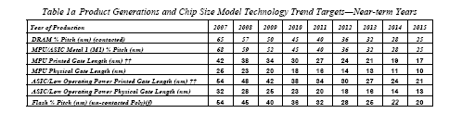
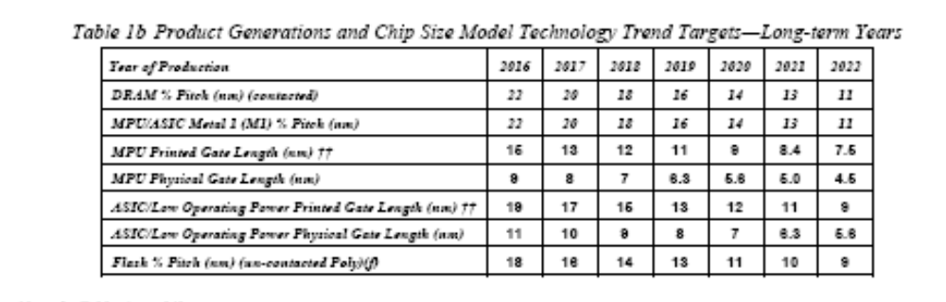

Slide 9
Technology Nodes
Year | 2001 | 2003 | 2006 | 2010 | 2013 | 2016
Technology Node | 130 | 100 | 70 | 45 | 32 | 22
Printed Gate length | 90 | 65 | 40 | 25 | 18 | 13
Equiv Physical Ox Thickness (nm) | 1.3-1.6 | 1.1-1.4 | 0.7-1.2 | 0.5-0.8 | 0.4-0.6 | 0.4-0.5
Litho Control 3σ (nm) | 5.15 | 3.64 | 2.29 | 1.45 | 1.02 | 0.72
Drain Extension Xj | 27-45 | 19-31 | 12-19 | 7-12 | 5-9 | 4-6
Fctn per Chip Prod (M trans) | 97 | 153 | 307 | 773 | 1546 | 3092
Wafer Size | 300 | 300 | 300 | 300 | 450 | 450

Slide 10
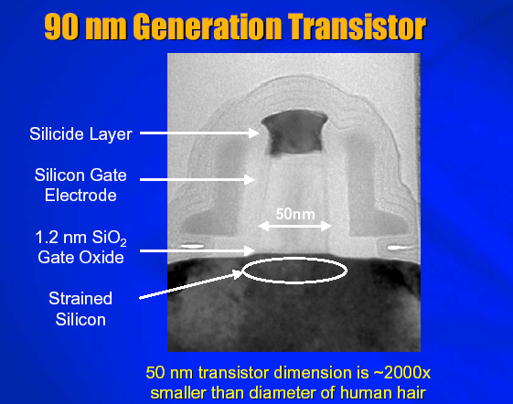
© Intel Research

Slide 11
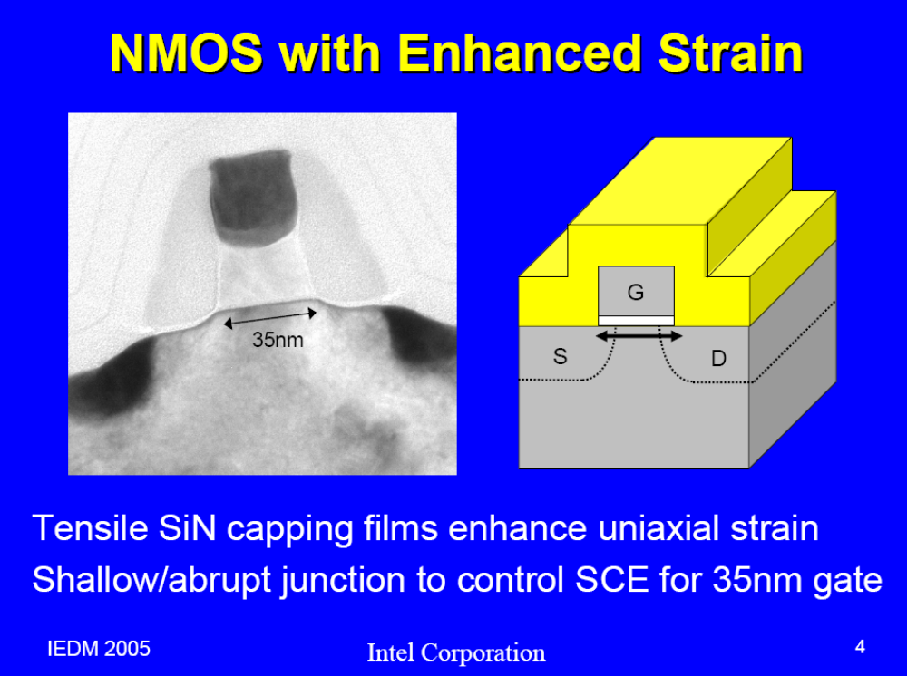

Slide 12
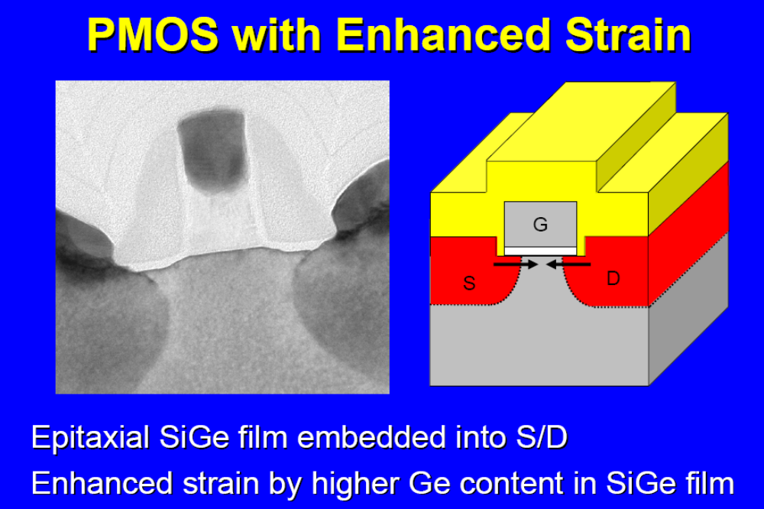

Slide 13
Process Working Groups
Process Integration, Devices & Structures
Front End Process
Lithography
Interconnect
RF Technologies
Non- Process Working Groups
Design
Test
Factory Integration
Assembly & Packaging
Environment
Defect Reduction
metrology
Modelling and Simulation

Slide 14
Front End Process
A: Gate Stack
B: Source-Drain
C: Isolation
D: Channel
E: Wells
F: Capacitor Stack/Trench
G: Starting Material
H: Contacts
A
F
C
B
H
D
E
G

Slide 15
Gate Stack Challenges
Extension of oxynitride dielectric materials to<1.0nm
Introduction and process integration of high k dielectric materials and processes
Enhanced channel mobility – strained layers
Minimized depletion of dual-doped polysilicon electrodes
Introduction of dual metal gate electrodes with appropriate work function
Metrology issues associated with gate dielectrics and gate stack electricial and materials characterization

Slide 16
Gate Dielectric I
This has emerged as one of the major challenges for future device scaling
Trends predict a dielectric with a required equivalent oxide thickness of less than 1nm
Tunnelling currents preclude the use of SiO₂ below about 1.5nm (Nitrided oxide actually went to 1.2nm)
  below this tunnelling currents of > 1A/cm² are predicted

Slide 17
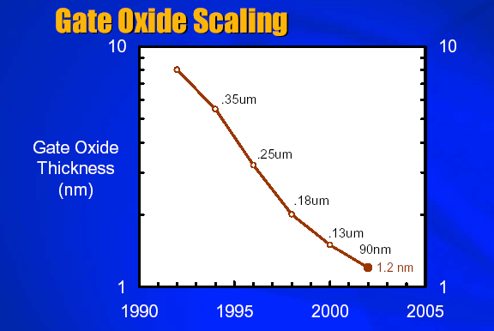
© Intel Research

Slide 18
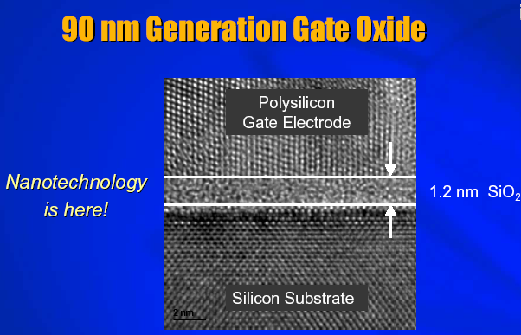
© Intel Research

Slide 19
Gate Dielectric II
Scale out of this material was predicted as early as the 100nm node
Improved thickness control will be needed to achieve V_{t} control for large diameter wafers
Intermediate and long term solutions require materials with high dielectric constants
  > 10 intermediate
  > 20 long

Slide 20
Gate Dielectric III
Another challenge is low leakage high k dielectrics will need bandgaps of 4-5eV with barrier heights > 1eV. In addition the candidate material must have negligible trap densities to limit Frenkle-Poole tunnelling

Slide 21
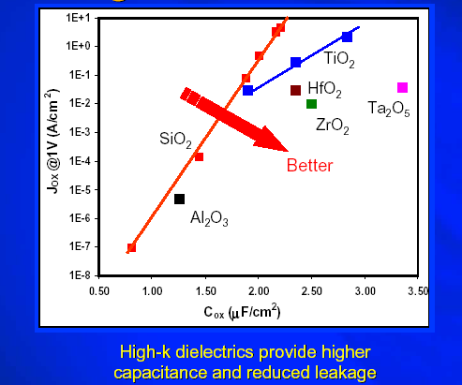
© Intel Research

Slide 22
Gate Dielectric Roadmap
First year of Production 1999 2002 2005 2008 2011 2014
Gate Dielectric
Oxide extensions
Modest k (5-10)
Medium k (10-20)
(amorphous)
Unary Oxides
Silicates
High k (>20)
Amorphous
Single Crystal
Nitride oxide
Nitride/oxide or Oxy-nitride Stack
Other Al₂O₃
Ta₂O₅ TiO₂ ZrO₂ HfO₂ Y₂O₅
Narrow Options
(La Ti, Zr, Hf…) SiO₄
LaAlO₃ ZrTiO₄ TiO₄ SrZrO₄
LaAl₃O₄ BaZrO₃ Y₂O₃ La₂O₃…
Research Required
Development Underway
Qualification/Pre-production

Slide 23
Strained Silicon
Thin layer of silicon in the channel region on top of a layer of silicon germanium
Germanium is a larger atom than silicon
The larger atom introduces strain into the crystal lattice
This improves electron mobility in the channel
Improving transistor speed

Slide 24
Minimised Depletion of Dual Doped Polysilicon
Dual doped polysilicon to better match work functions
Usually done with the Source implants
Not as heavily doped as furnaced doped poly
Can lead to depletion zones

Slide 25
Lithography
Lithography continues to be the key enabler and driver for the semiconductor industry
Lithography currently represents over 35% of chip manufacturing costs
The key elements of lithography include:
  Exposure equipment
  Resist materials
  Mask making, mask equipment and materials
  Metrology equipment for critical dimension and overlay

Slide 26
Lithography II
Optical lithography continues to be the the mainstream technology
Extensions of optical lithography are being used to support 130nm product and process development
Resolution Enhancement Techniques (RET)
  Off Axis Illumination (OAI)
  Phase Shifting Masks (PSM)
  Optical Proximity Correction(OPC)
  Wavelength reduction (193nm → 157nm)
  Immersion Lithography
Industry momentum behind optical techniques to 100nm, the challenge is process latitude

Slide 27
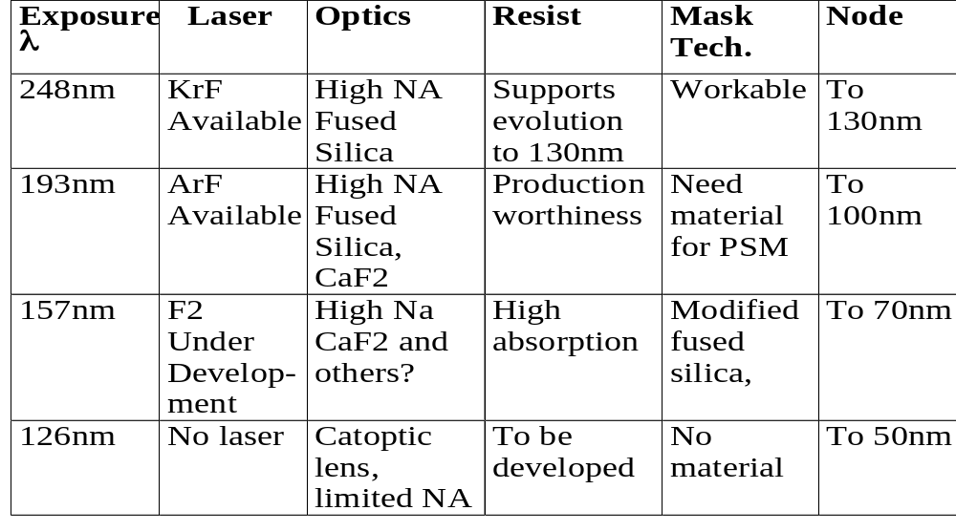
Wavelength Reduction
Bluejohn

Slide 28
Optical Proximity Correction (OPC)
Optical and process proximity effects cause significant distortions in the patterns transferred from mask to wafer
Photomasks have moved from being mere master images of the chip to being complex optical instruments in their own right
Proximity distortions escalate rapidly as dimensions drop
Models can be used to predict pattern shapes

Slide 29
OPC
Design Layout
Mask Layout
Result on Wafer

Slide 30
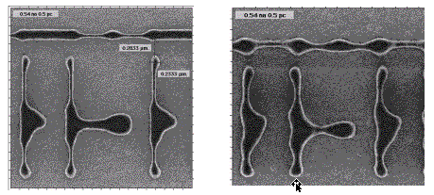
Pattern Distortion
Pattern distortions occur when the critical dimensions are reduced below the wavelength of the light used (248nm)

Slide 31
Phase Shifted Masks (PSM)
At feature sizes below the wavelength of the exposure light inherent diffraction effects blur feature edges
PSMs reduce or eliminate zero order mode of impinging light using adjacent structures 180° out of phase
The 180° out of phase and the original wave destructively interfere at the feature edges, tending to sharpen the aerial image
Two types of PSM - Alternating/strong shifters Embedded/halftone or attenuated shifters

Slide 32
PSMs
Mask
Amplitude
at mask
180° phase
shift
Amplitude
at wafer
Intensity
at wafer

Slide 33
Off-axis Illumination (OAI)
Aperture
On-Axis Illumination
“Lost”
Diffracted
Light
Projection Lens
Mask
Wafer
“Captured”
Diffracted
Light
Off-Axis Illumination
“Lost”
Diffracted
Light

Slide 34
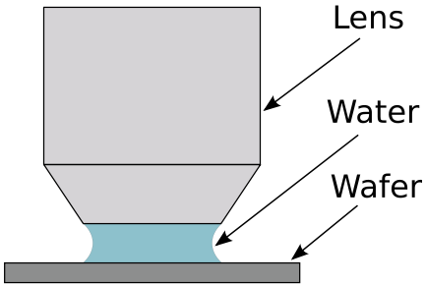
Immersion Lithography

Slide 35
Challenges for Lithography
≥50nm/Through 2009
Optical masks with features for Resolution Enhancement and post optical mask fabrication
Cost Control and ROI
  Improving ratio of tool cost to throughput
  Sufficient lifetime for the technologies
  High output cost effective EUV light source
Process control gate CDs to less than 1.8nm (3Σ)
  Overlay to less than < 19nm
Resists for ArF, Immersion Lithography and F₂
CaF₂

Slide 36
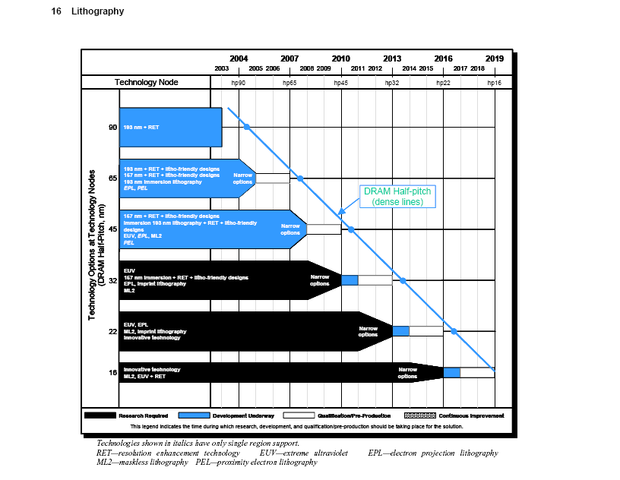

Slide 37
Interconnect I
Five difficult challenges ≥ 45nm through 2009
  New materials
  Engineering manufacturable interconnect structures compatible with new materials and processes
  Reliability
  3 Dimensional Control of interconnect features
  Manufacturability and defect control to meet cost/performance requirements
<45nm/Beyond 2009
  Mitigate impact of size effects in interconnect structures
  3-D control of interconnect features
  Patterning cleaning and and filling at nanodimensions
  Integration of new processes and structures including interconnects for emerging devices
  Identify (unconventional)solutions which address global wiring scaling issues

Slide 38
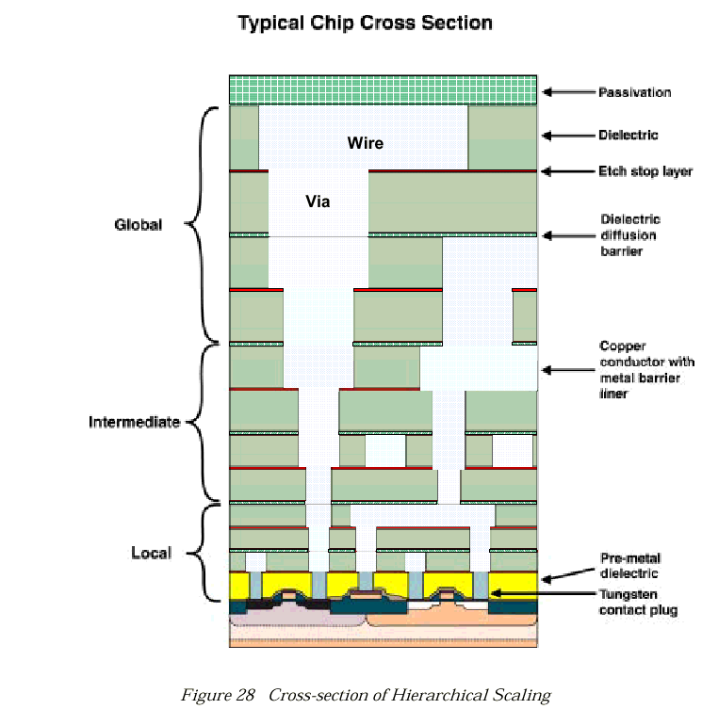

Slide 39
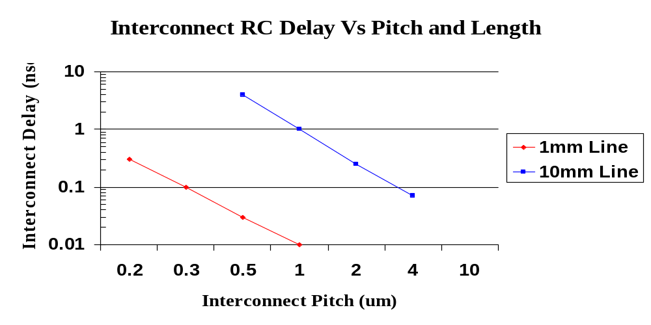
Aluminium/Sio2 Interconnect

Slide 40
Interconnect Issues I
Interconnect RC delay increases as interconnect pitch decreases, due to increase in line resistance
Pitches need to be scaled with every technology generation to keep pace with density requirements

Slide 41
Interconnect Issues II
One way to deal with performance is to add more metal layers
  this can help density without having to scale the pitch as aggressively
Increased aspect ratio is another way of maintaining performance
  this does increase capacitance

Slide 42
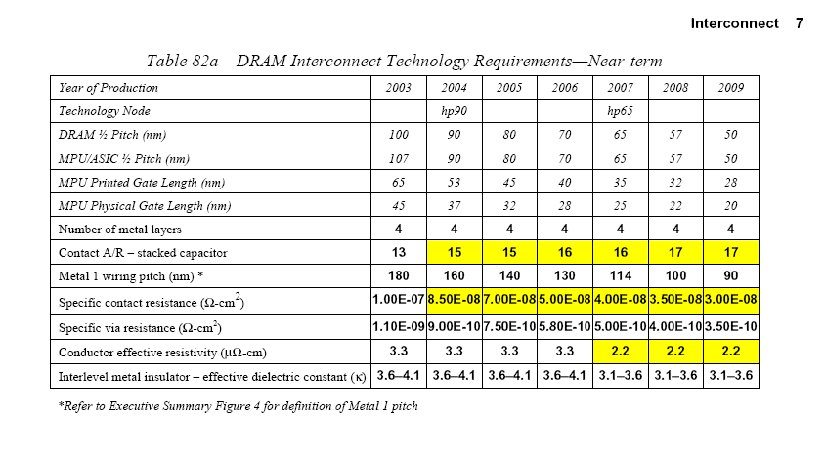

Slide 43
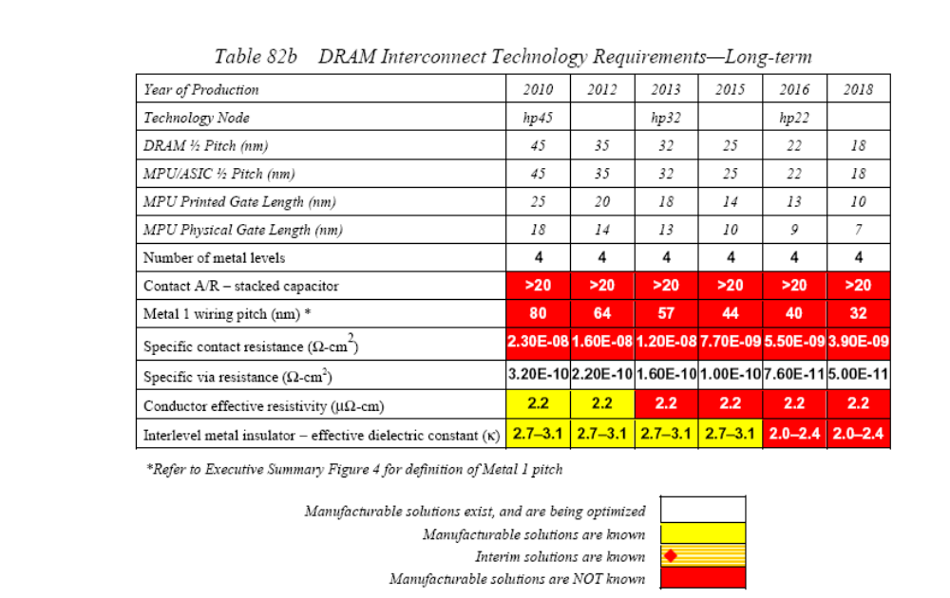

Slide 44
Interconnect Roadmap Table for MPUs 2001
Year | 2001 | 2003 | 2006 | 2010 | 2013 | 2016
Technology Node | 130 | 100 | 70 | 45 | 32 | 22
MPU Gate Length (printed) | 90 | 65 | 40 | 25 | 18 | 13
MPU ½ Pitch | 150 | 107 | 70 | 45 | 32 | 22
Number of metal levels | 8 | 8 | 10 | 10 | 11 | 11
Interlevel Metal insulator eff k | 3.0-3.6 | 3.0-3.6 | 2.6-3.1 | 2.1 | 1.9 | 1.8
Wafer Size | 300 | 300 | 300 | 300 | 450 | 450

Slide 45
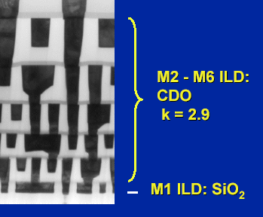
Interconnect – Low k Dielectric
Target in 2001 roadmap
  100nm Node – 3.0-3.6
  70nm Node – 2.6-3.1
Actual in Intel 90nm Process
  CDO Carbon Doped Oxide
  2.9
© Intel Research

Slide 46
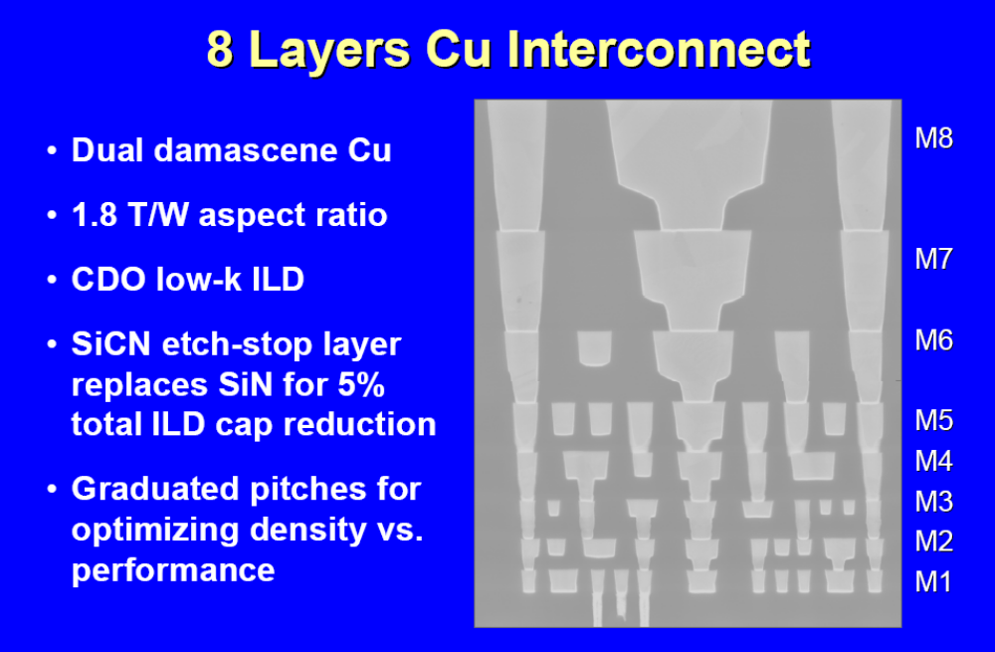
65nm Process
© Intel Research

Slide 47
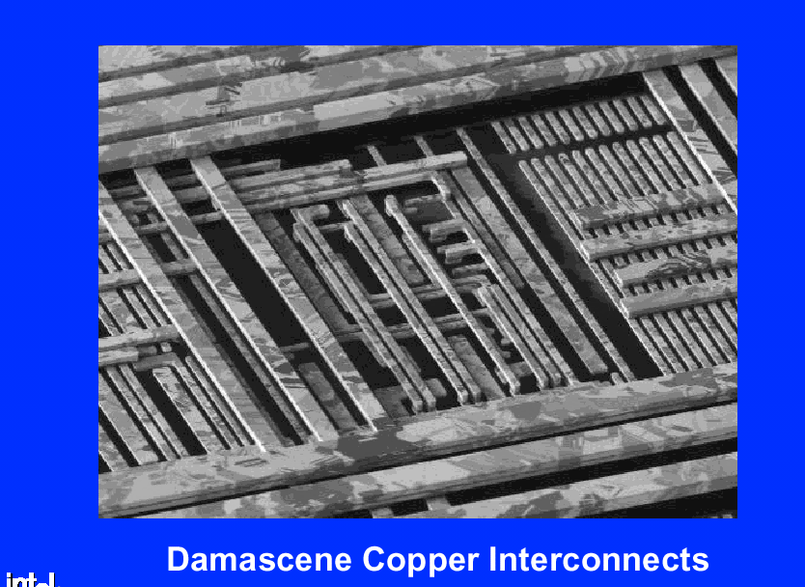
© Intel Research

Slide 48
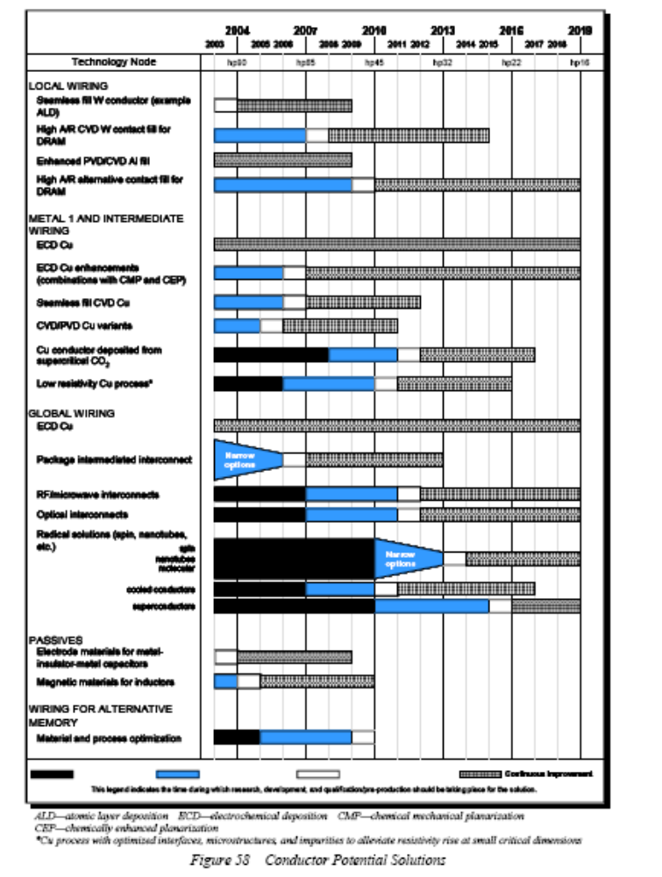

Slide 49
Interconnect Summary
Copper was introduced to MPUs at the 220nm node
For very high speed DRAMs Cu will also be used but in the main DRAM will not use Cu until the 100nm node
It is necessary to get beyond the 2.2μΩ-cm effective resistivity characteristic of barrier/Cu
Solutions <100nm
  Reduction of operating temperature to allow the use of super conducting material
  Optical interconnect

Slide 50
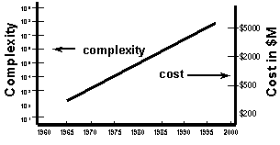
Moore’s 2nd law

Slide 51
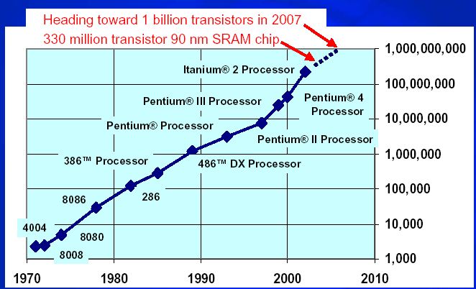
Moore’s Law Goes On
32nm due for introduction in 2009 will have 1.9B transistors
© Intel Research

Slide 52
Bibliography
ITRS 2001
  http://public.itrs.net/Files/2003ITRS/Home.htm
A closer look at some of the most difficult processing challenges - Pieter Burggraaf; Solid State Technology, Sept, 2000
1999 Roadmap: Solutions and Caveats; Solid State Technology; May, 2000
TCAD physical verification for reticle enhancement techniques; Mike Rieger: Solid State Technology; July, 2000
Blue Moon Rises over Silicon Valley; Bill Arnold: Semiconductor Magazine; June 2000
Future IC Fabrication Rests on Solutions to Scaling Issues: Zeitoff et al; Solid State Technology, July 2002, p71.
Challenges of Next generation Lithography; John Canning: Semiconductor International; Sept, 2000
Technology for Advanced High-Performance Microprocessors Mark T. Bohr, Y. A. El-Mansey; IEEE Transactions on Electron Devices Vol. 45 No. 3 March 1993
IBM Paving the Way to 0.10 Micron; Microprocessor; Vol. 14, May 2000
Blue john gains capacity; David Larner: European Semiconductor; Oct. 2000
http://www.intel.com/research/silicon

